Slide 1
Event Sphere
thefunteam: Daniel Chae, Sungmin Choi, Brian Huynh, Youngha Kweon, HaDong Park

Slide 2

Vision Statement
Our app connects university students with campus events, making it easier to engage with their community. By centralizing event details, we offer a convenient, user-friendly alternative to scattered announcements.
Features & Goals:
Event Discovery: See all events across campus, from student organizations, clubs, and sports to individual gatherings.
Customization: Filter by event categories, such as clubs or sports, to find what interests you.
Community Building: Join or create sub-communities, allowing targeted announcements and group planning.
Convenience: Access event locations, announcements, and updates all in one app for a streamlined campus experience.
Our goal is to become the primary event hub for students, supporting involvement and enhancing campus life.

Slide 3
Demo
Go over Create event, click on the event, search functionality
Show that the events update based on added events
Data stored on data Service

Slide 4
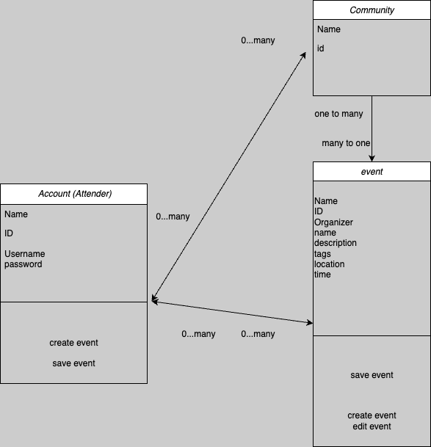
DOM Model

Slide 5
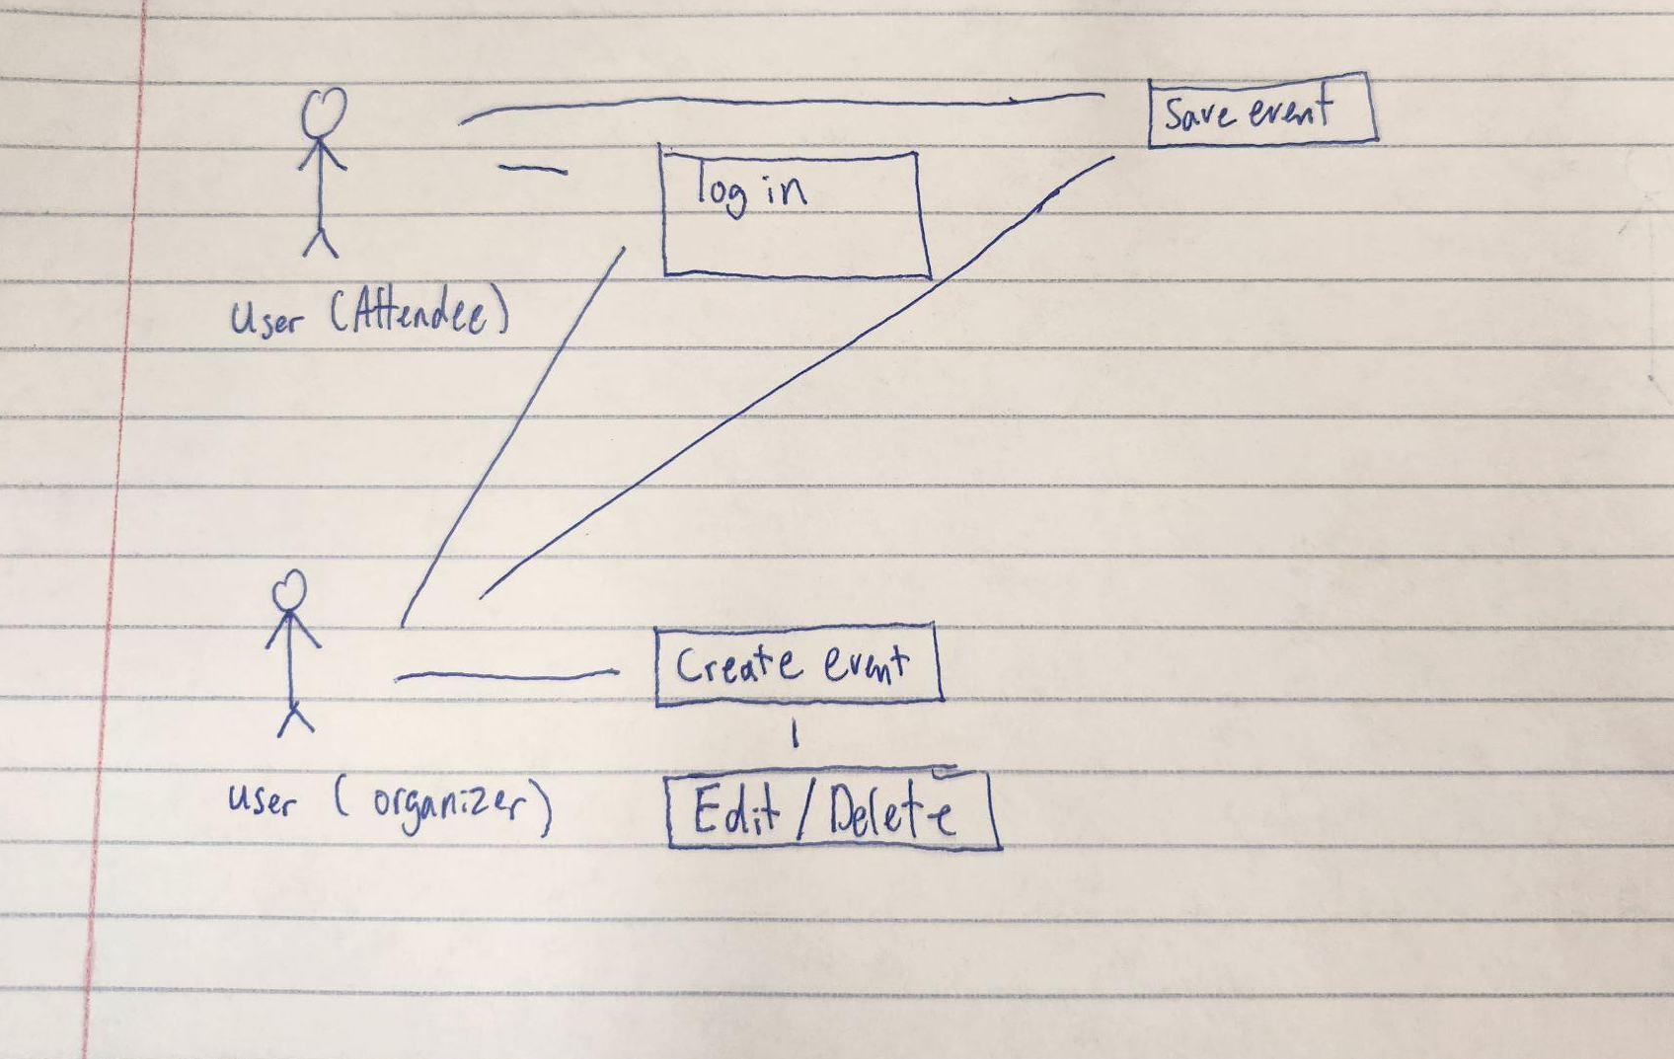
User Model

Slide 6
Status Report: Whats next?
User Accounts Create profiles and personalize the event experience.
Community Features
Community-Specific Events: Add events that only members of a community can see.
Roles: Join communities as a Member or Leader.
Event Ownership
Event Creator Role: Distinguish creators from standard users; only creators can edit or delete their events.
Enhanced User Functions
RSVP & Sign-Ups: View RSVP counts and sign-ups for events.
Detailed Event Info: Access more visible event details and smaller interactive features.
Notes:
Brian

Slide 7
Questions?

